Slide 1
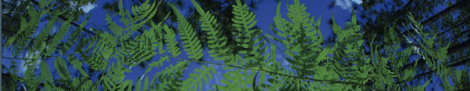

R-based Data Downloads
Shelly Gaynor
University of Florida

Slide 2
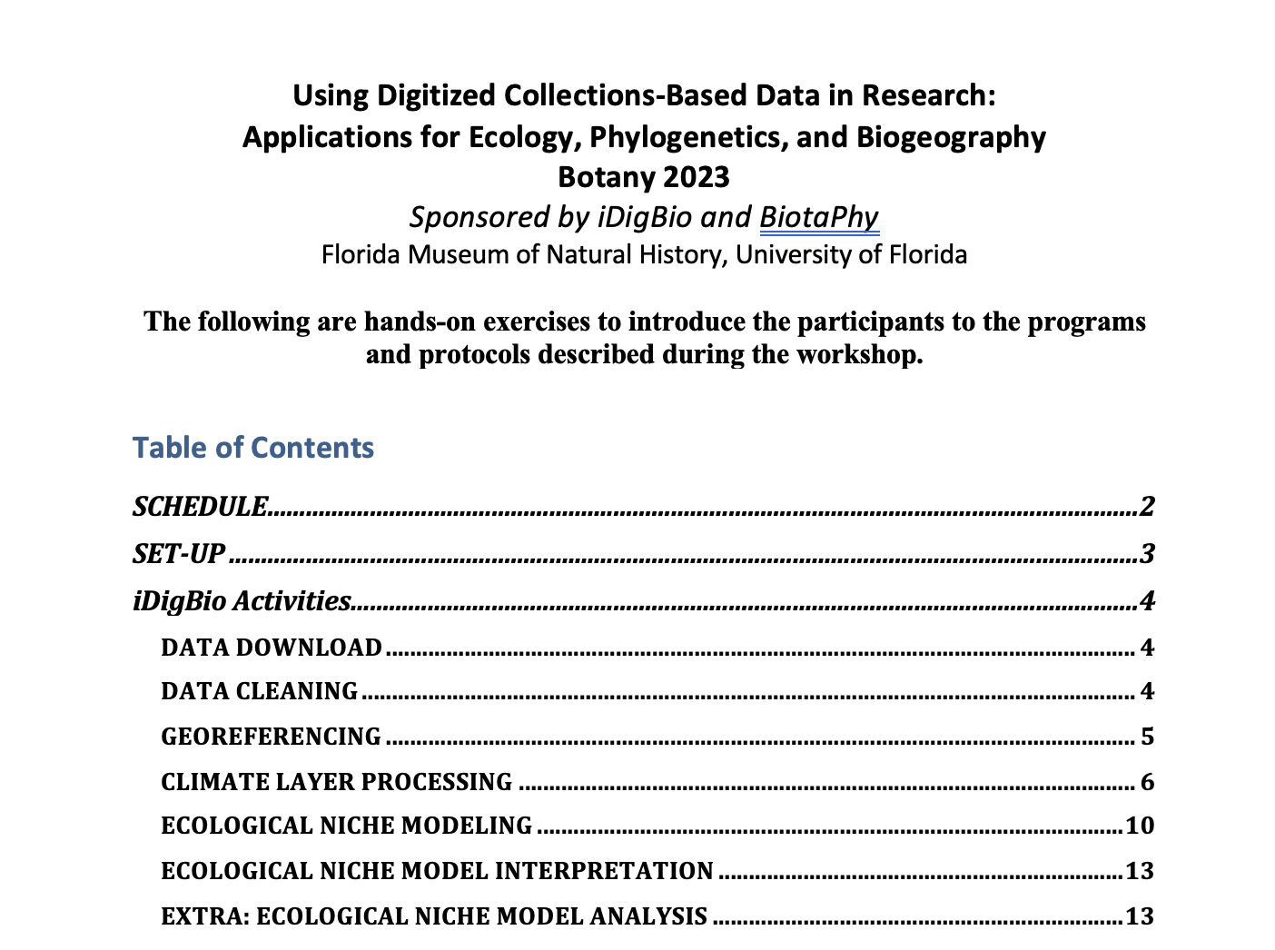
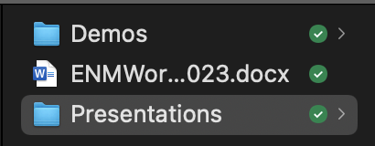
Workshop setup
Workshop Guide

Slide 3
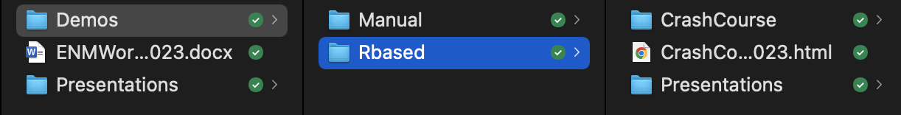
Workshop setup
HTML Version of all R scripts

Slide 4
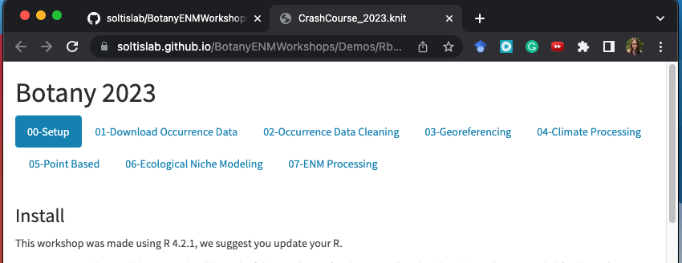
Workshop setup
https://tinyurl.com/4nk7zcws
Contains additional troubleshooting steps
Notes:
Great way to follow along during the workshop!

Slide 5
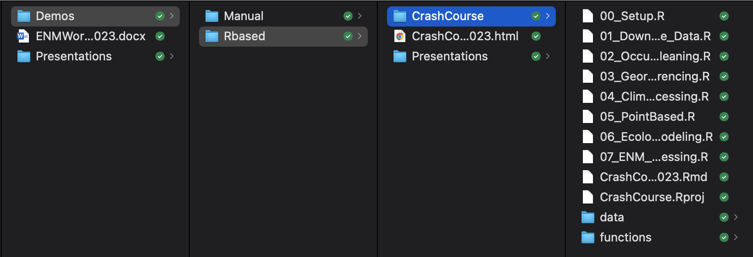
Workshop setup
Opens the R project

Slide 6
Workshop setup
Run before the workshop started!
How the R project was made
All data and functions needed for these scripts

Slide 7
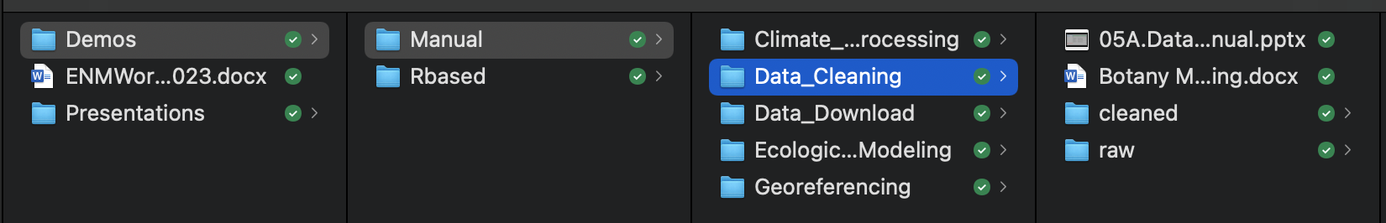
Workshop setup
Instructions

Slide 8
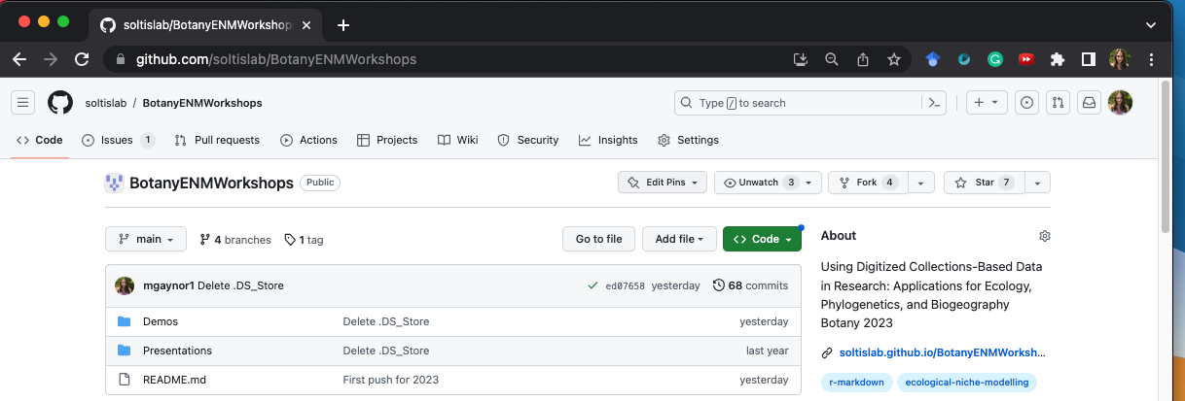

Slide 9
01-Data Download
University of Florida

Slide 10
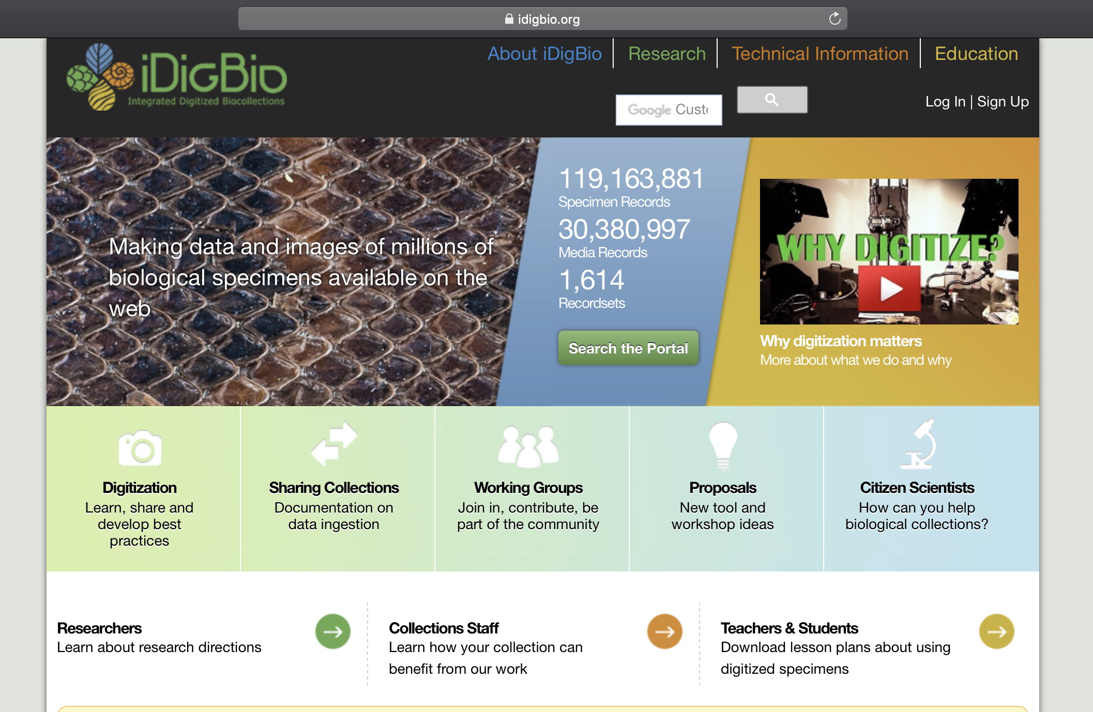

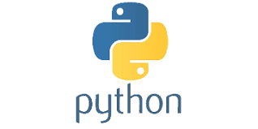
API = Application Programming Interface
Allows users to interact with a system
Web portal
API
Database
Interface

Slide 11
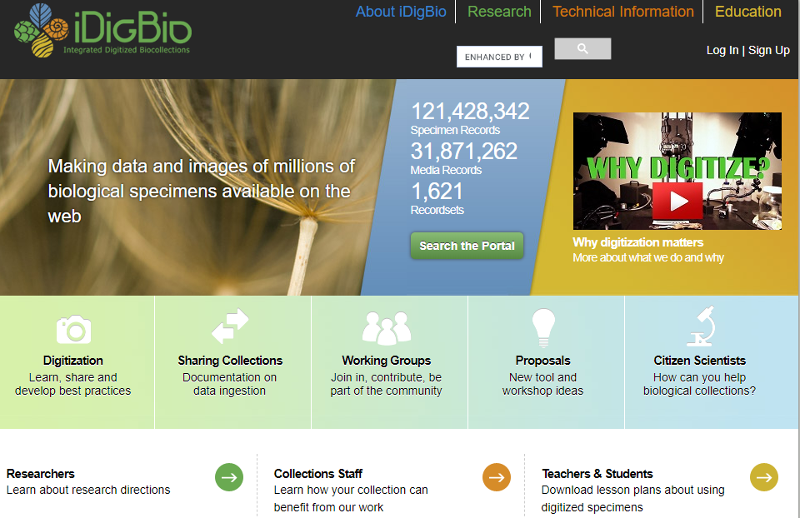

Slide 12

iDigBio API
Multiple ways to access the API:
API Name | Info
Search API | ridigbio R package <100,000 records
Download API | >100,000 records
Record API | Single record
Media API | Single record
biodiversity-specimen-data/specimen-data-use-case

Slide 13
iDigBio API
Multiple ways to access the API:
API Name | Info
Search API | ridigbio R package <100,000 records
Download API | >100,000 records
Record API | Single record
Media API | Single record
biodiversity-specimen-data/specimen-data-use-case

Slide 14
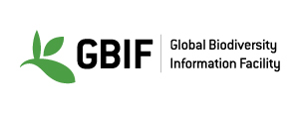
GBIF API
Multiple ways to access the API:
API Name | Info
Registry API | Create, edit, update and search for information about datasets
Species API | Taxonomy API
Occurrence API | Record API
Maps API | Show maps of GBIF
News API | Search papers published using GBIF
https://www.gbif.org/developer/summary

Slide 15
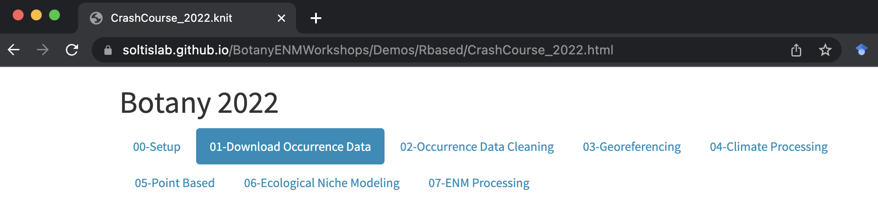
R based
https://tinyurl.com/msdurpk
“Demo/Rbased/CrashCourse/CrashCourse.Rproj”
Navigate to 01_Download_Occurence_Data.R

Slide 16
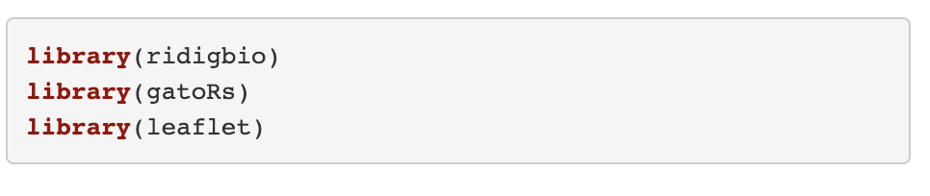
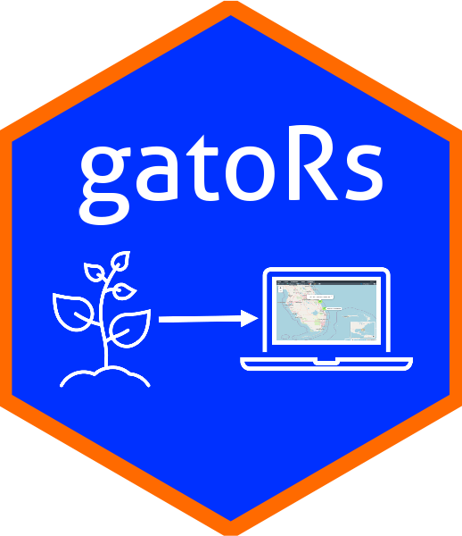


Load Packages
Notes:
spocc- Global Biodiversity Information Facility ('GBIF'), 'USGSs' Biodiversity Information Serving Our Nation ('BISON'), 'iNaturalist', Berkeley 'Ecoinformatics' Engine, 'eBird', Integrated Digitized 'Biocollections' ('iDigBio'), 'VertNet', Ocean 'Biogeographic' Information System ('OBIS'), and Atlas of Living Australia ('ALA'). Includes functionality for retrieving species occurrence data, and combining those data.
Ridigbio-Interface to the iDigBio Data API

Slide 17
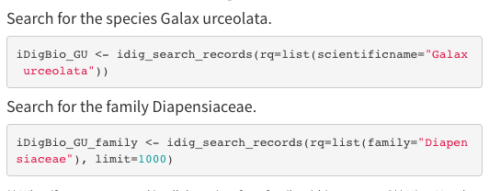
Downloading data using ridigbio
First, we are searching for the species Galax urceolata
Next, download occurrence records for the family Diapensiaceae

Slide 18
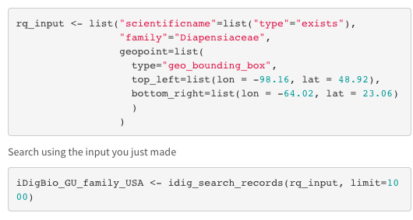
Records only in North America

Slide 19
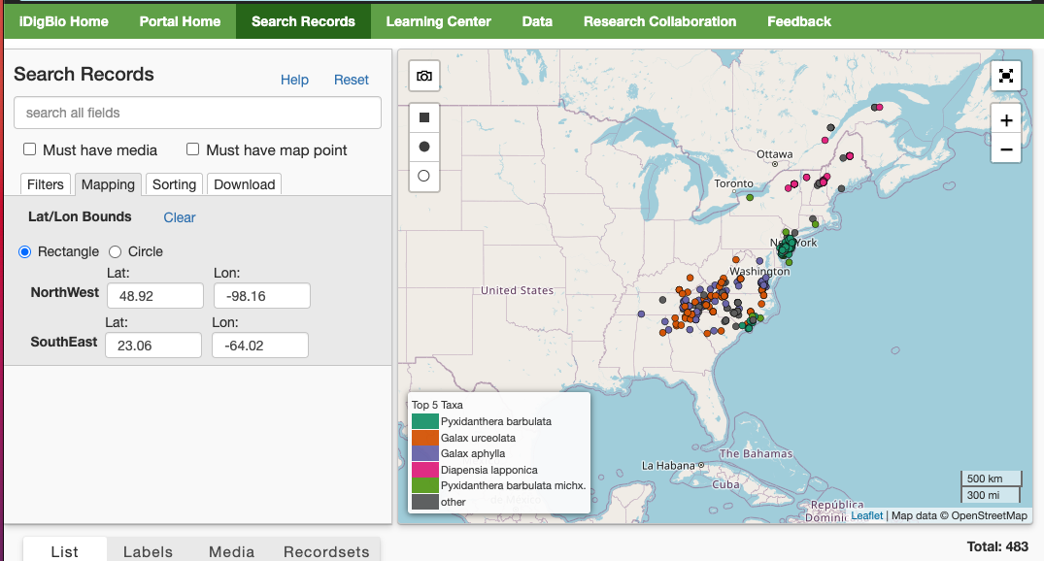

Slide 20
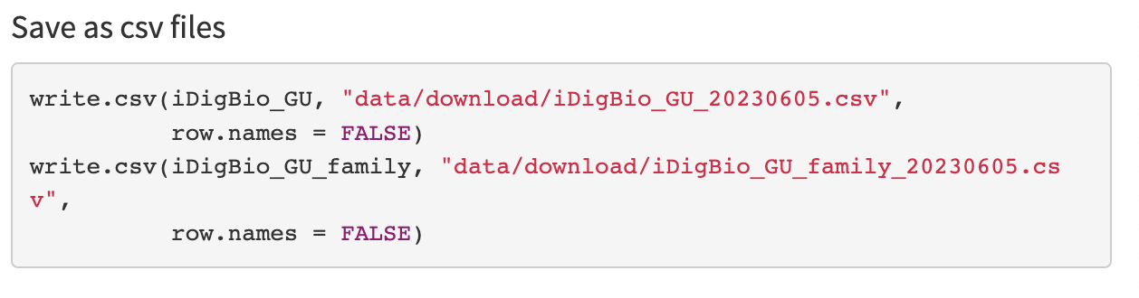
Save as csv

Slide 21
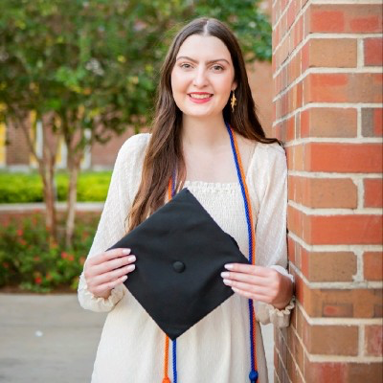



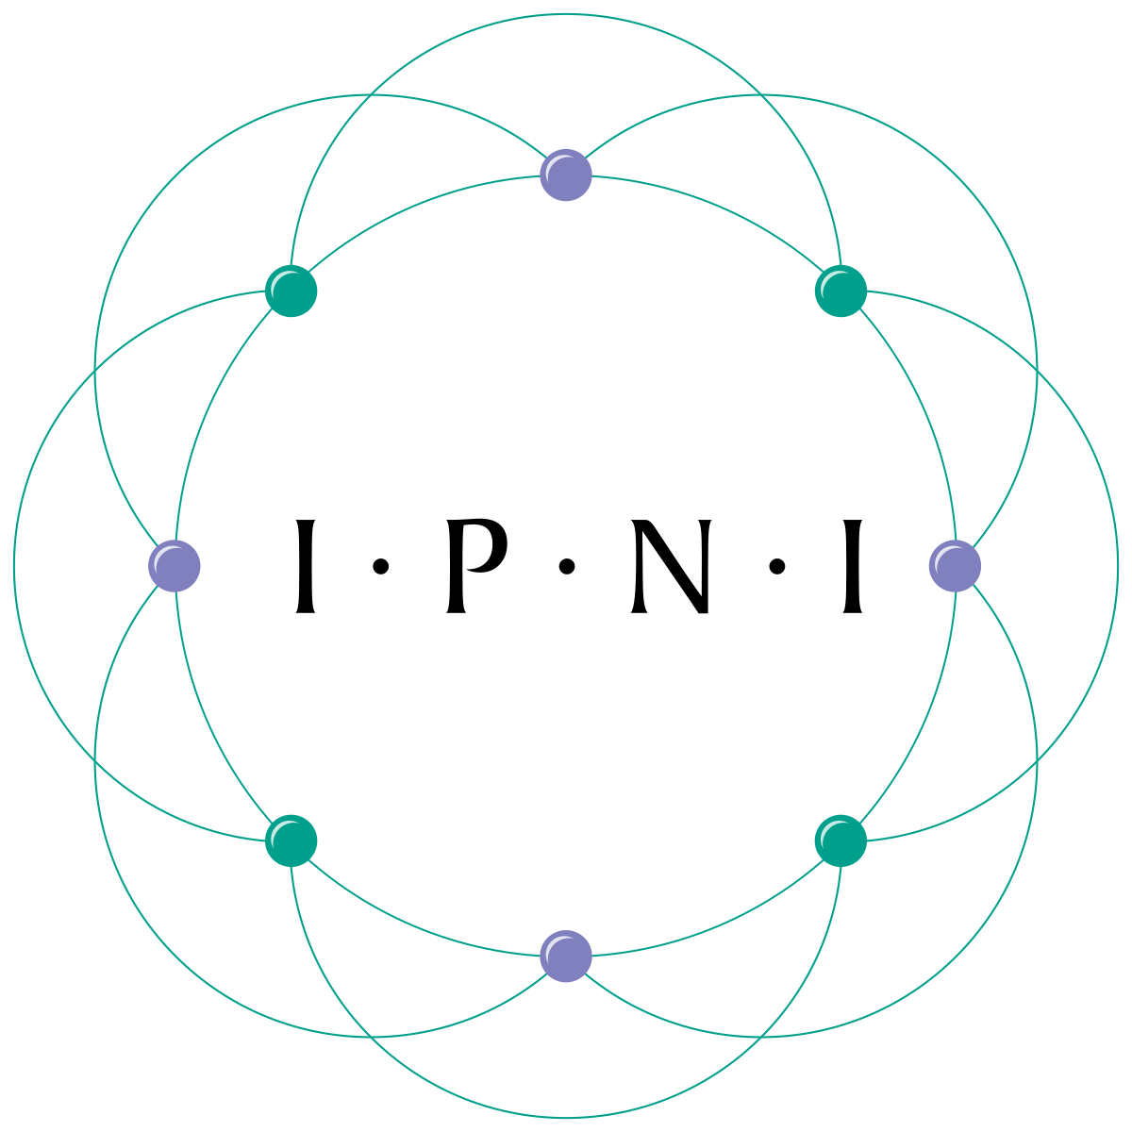


Data download using gatoRs
To pull data from GBIF and iDigBio for a set of synonyms
Identifying synonyms:
Taxonomic Name Resolution Service
https://tnrs.biendata.org/
Used in soltislab/BotanyENMWorkshops 2020
R package taxize
20 sources for synonyms
https://docs.ropensci.org/taxize/
Natalie Patten

Slide 22
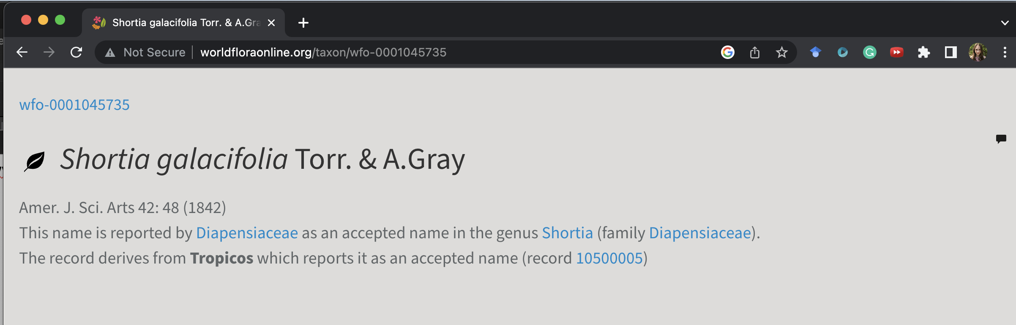

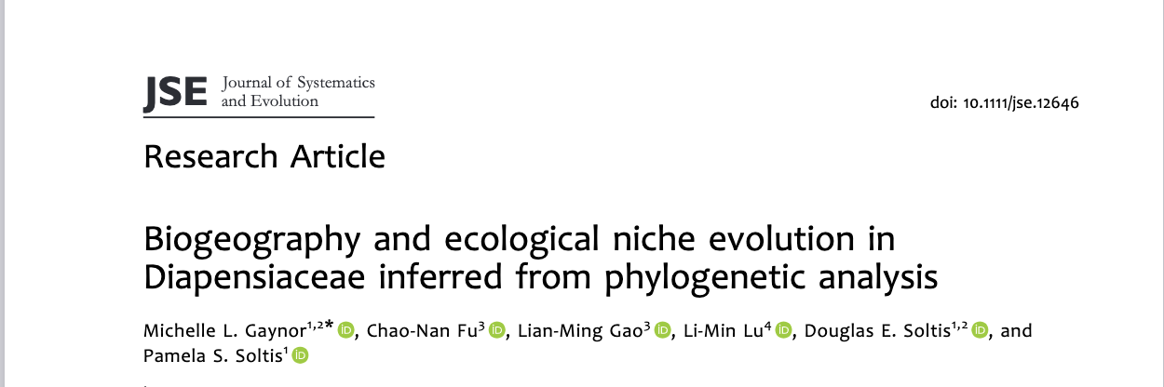
http://www.worldfloraonline.org/
Where these synonyms are from:

Slide 23
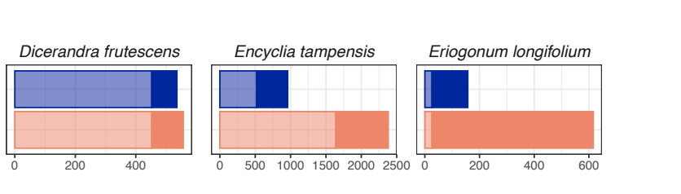
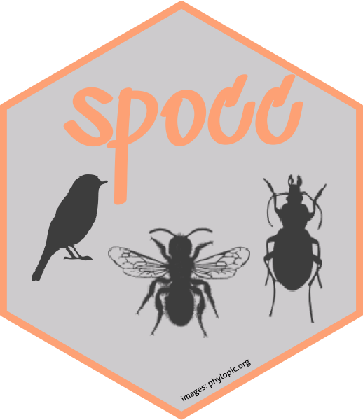
Why should I use gatoRs?
GBIF
iDigBio
Downloaded Records
Patten et al. In Review. Applications in Plant Science

Slide 24
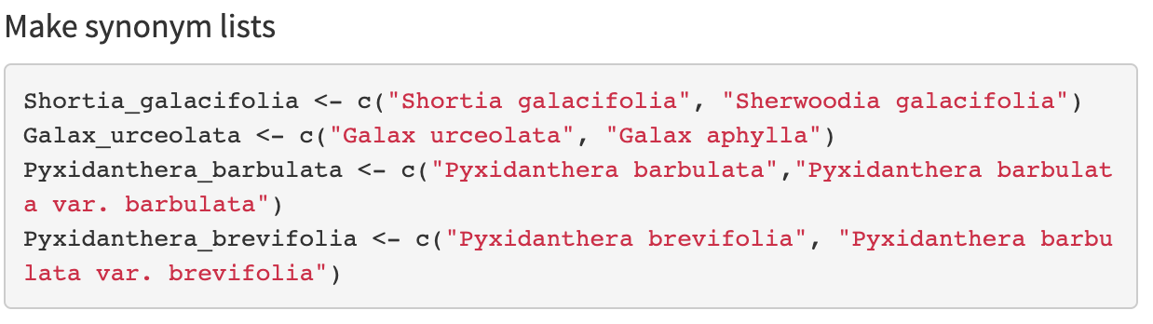
Data download using gator_download
Object
List of strings

Slide 25
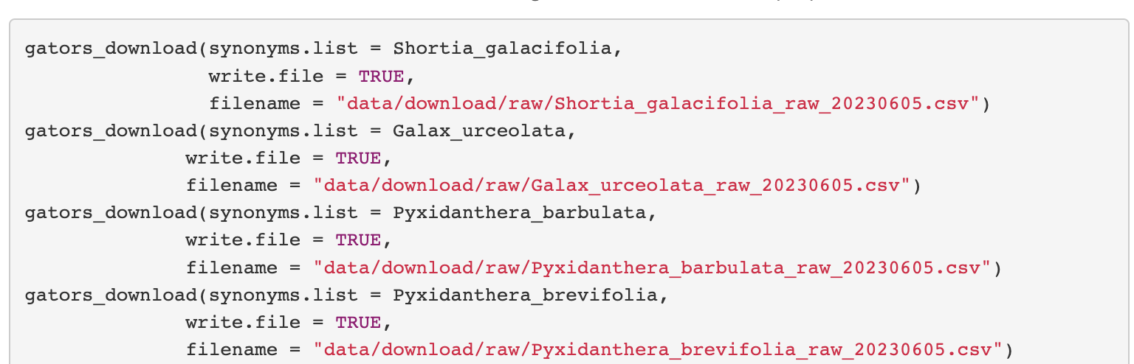
Data download using gators_download
,
Synonym list
Save csv file

Slide 26
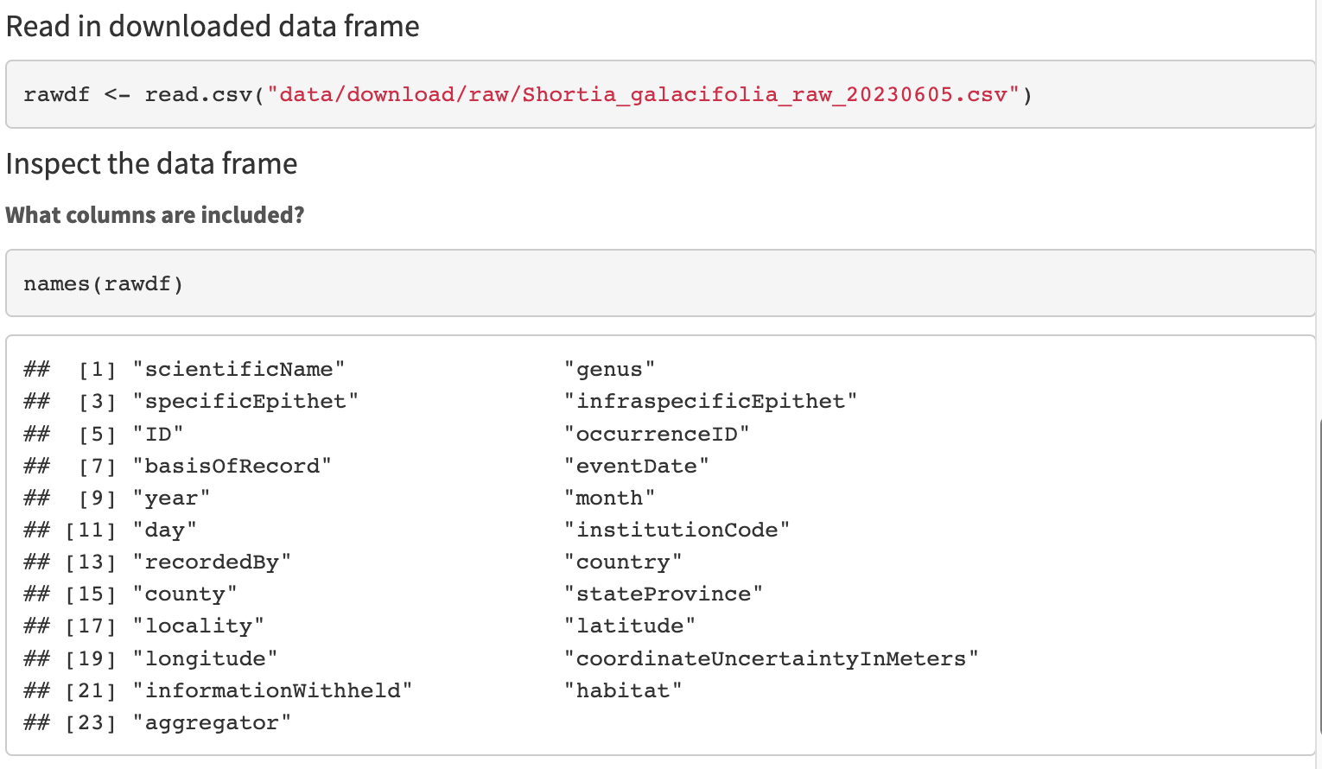
Quick-look at downloaded files

Slide 27
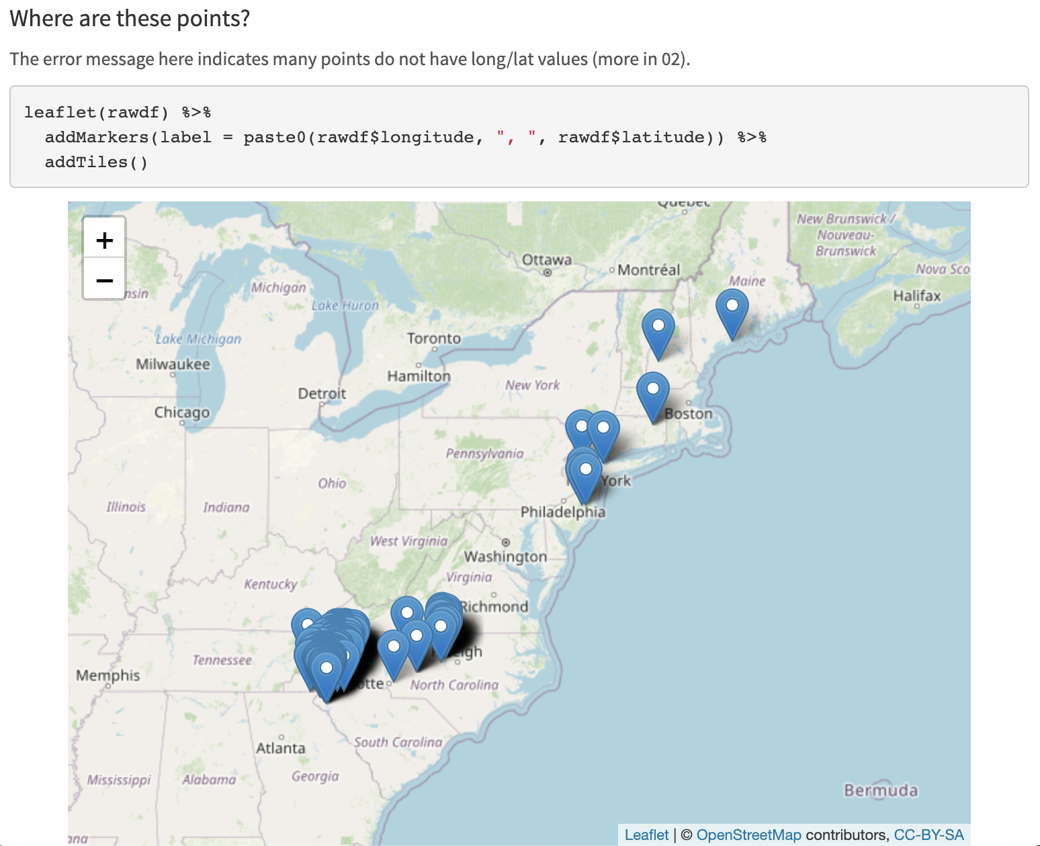

Slide 28
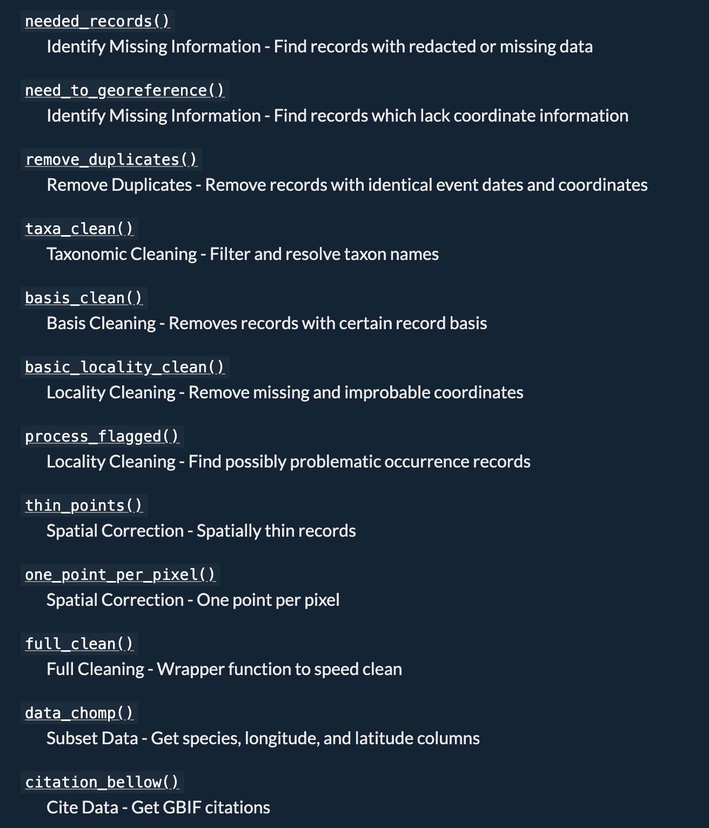
Patten et al. In review. gatoRs: Geographic and Taxonomic Occurrence R-Based Scrubbing. nataliepatten/gatoRs

